Slide 1

BlockbusterBase A Relational Database for the Hollywood Film Industry
By
Yeswanth Chitturi
Neeraj Gummadi
Baby Naina Tara Korivi

Slide 2
Project Overview
BlockbusterBase is a relational database system tailored for the Hollywood film industry.
Designed to store and manage information about movies, actors, directors, studios, awards, and streaming platforms.
Built using PostgreSQL with a fully normalized schema (BCNF).
Scalable and query-efficient, supporting 3000+ records per table.
Supports advanced analytics, transactional integrity, and future extensibility.

Slide 3
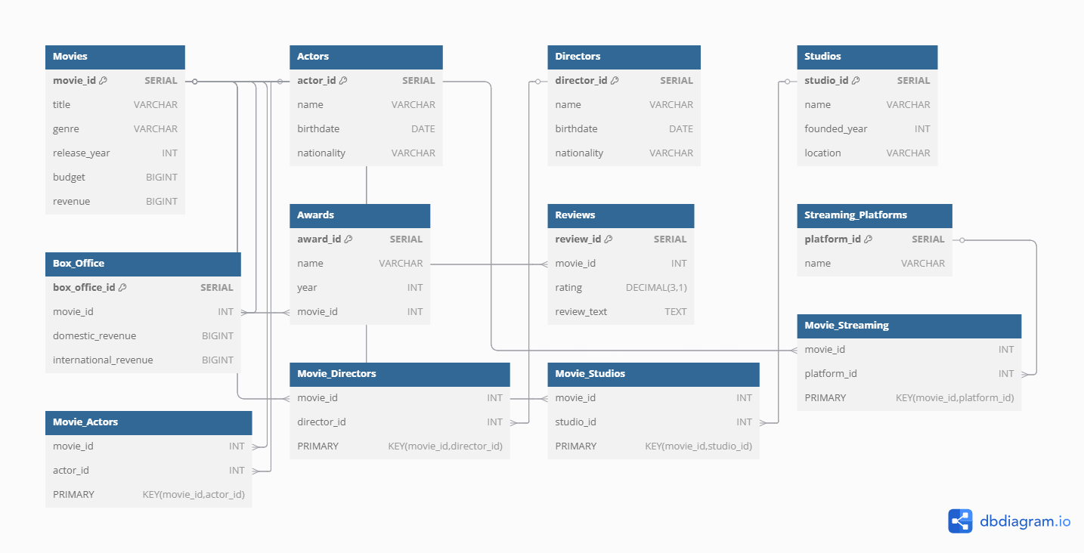
ER Diagram & Schema Design
10+ interrelated tables representing entities like Movies, Directors, Studios, Actors, Awards, etc.
Clearly defined Primary and Foreign Keys to enforce referential integrity.
Many-to-many relationships handled using junction tables (e.g., Movie_Actors, Movie_Streaming).
Data types and constraints carefully chosen for efficiency and accuracy.

Slide 4

Schema Normalization (BCNF)
All relations were normalized to Boyce-Codd Normal Form (BCNF).
Ensured elimination of redundancy and update anomalies.
Identified functional dependencies for each relation during design.
One exception: the Awards table was retained in 3NF to preserve readability and minimize join complexity.
Normalization improved consistency across large-scale insertions (3000+ rows per table).

Slide 5

Data Generation with Python & Faker
Used Faker library in Python to generate realistic data (names, cities, dates, etc.).
Script populates over 3000 rows per table for all entities.
Data inserted directly into PostgreSQL using psycopg2.
Covers Movies, Studios, Directors, Actors, Streaming Platforms, Reviews, Awards, etc.
Ensures cross-table consistency with primary and foreign key lookups.

Slide 6
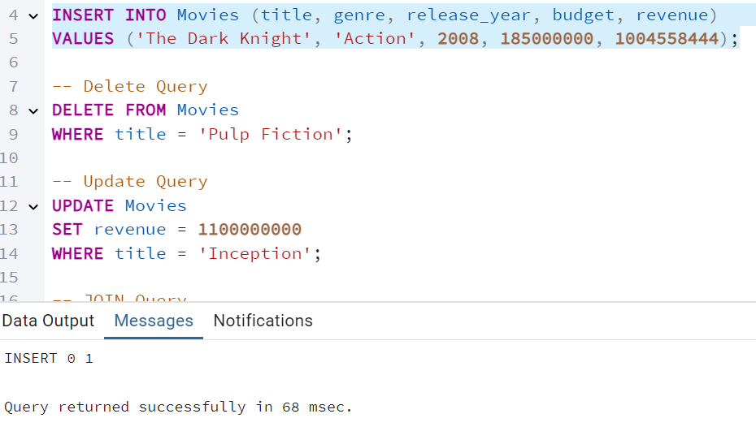
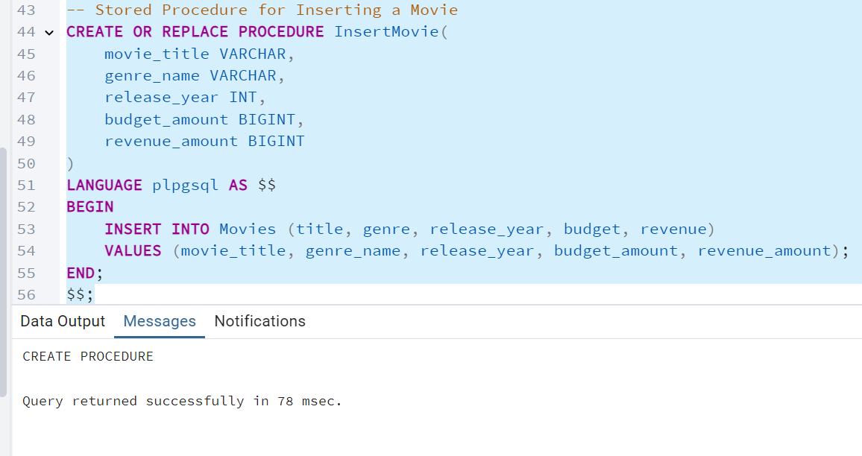
SQL Query Demonstration
Demonstrated key SQL operations:
INSERT, DELETE, UPDATE on Movies table
SELECT with JOIN to retrieve movie-director relationships
ORDER BY, GROUP BY, and Subqueries for analytics
Created Stored Procedures for reusable operations:
Insert/Remove movie
Get all movies by a director

Slide 7
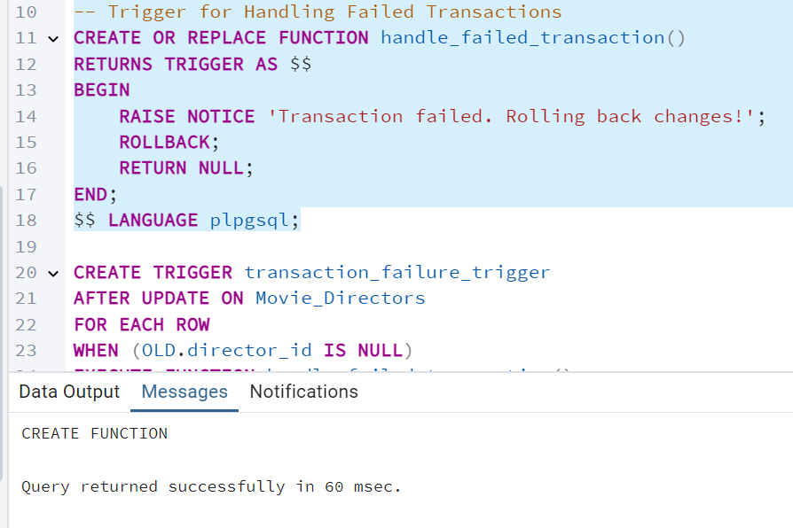
Transactions & Failure Handling
Implemented a transaction to transfer movies from one director to another.
Ensured atomicity using PostgreSQL’s BEGIN / COMMIT.
Created a trigger function (handle_failed_transaction) to detect and log failures.
Trigger is activated on failure, preventing partial updates.
Demonstrates safe rollback and consistent data state.

Slide 8
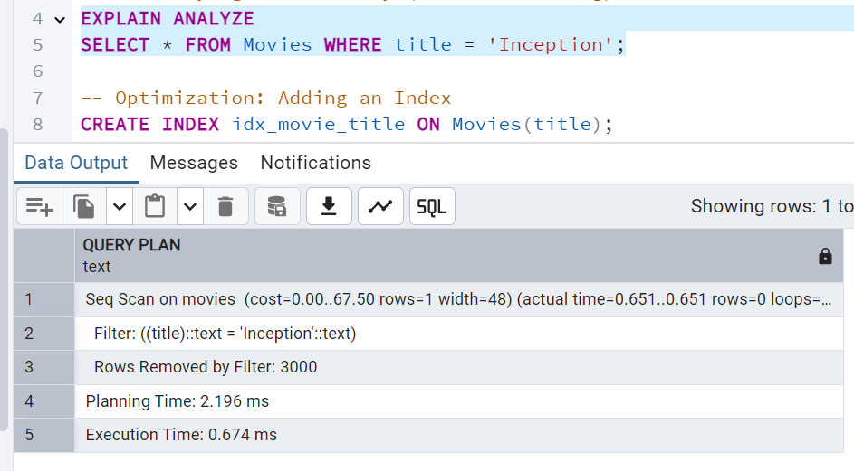
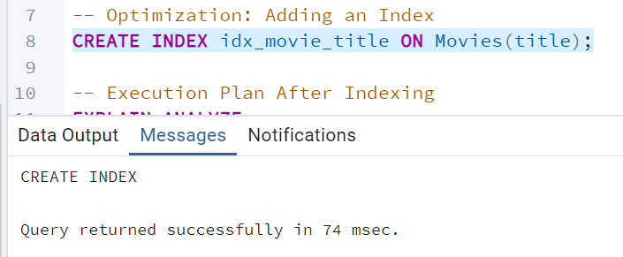
Query Performance & Indexing
Used EXPLAIN ANALYZE to assess performance bottlenecks.
Identified three slow queries:
Search by title
Filter by release_year
Join on Movie_Directors and Directors
Created indexes on key columns to optimize access:
Movies(title), Movies(release_year), Movie_Directors(director_id)
Achieved significant reduction in query execution time.
Query plans showed shift from sequential scans to index/bitmap scans.

Slide 9
Project Summary & Key Strengths
Scalable Design: Supports 10+ relations with 3000+ rows per table.
Normalized Schema: BCNF ensures minimal redundancy and consistent updates.
Efficient Querying: Optimized using indexing and stored procedures.
Robust Transactions: Safe updates with rollback and trigger-based failure handling.
Extensible Architecture: Ready for future analytics, APIs, or frontend integration.

Slide 10
Future Scope & Extensions
User Account & Access Control Add authentication, roles (admin/viewer), and permission-based query access.
REST API Integration Enable frontend or mobile app connectivity via Flask or FastAPI.
Dashboard & Visualization Use Power BI/Tableau to track box office trends, genre distribution, or award stats.
Time-Series Analysis Analyze movie revenue growth over time using PostgreSQL time functions.
Dataset Expansion Integrate external APIs like OMDb or TheMovieDB for enriched metadata.

Slide 11

Thank you

